Slide 1
18CSP107L
Minor Project
Final Review (04-11-2023)
Panel : 37
Panel Head : Dr. S.Pradeep (101242)
Panel Member: Dr. K.Priyadharshini (103105)
Batch Id: 550
Student 1 : Ayush Srivastava (RA2011003010759)
Student 2 : Hansa Verma (RA2011003010799)

Slide 2
AgroNexa : A Farm equipment rental portal with ML based equipment recommendation system

Slide 3
Index
Project Title & Abstract 3
Problem statement and Objective 4
Proposed Methodology 6
Architecture / Block Diagram of the proposed model 8
Modules Description and Implementation (100%) 14
Results and Discussion 21
Output and Screenshots 24
References 27

Slide 4

AgroNexa
The foundation of many economies, agriculture must simultaneously ensure that farming practices are sustainable while boosting food supply to satisfy rising global demand. Innovation in the agricultural sector is more important than ever in the context of India, where millions of people depend on it for their livelihood. The "AgroNexa," or Farm Equipment Rental Portal, appears as a revolutionary way to deal with these issues.
AgroNexa is an online platform that connects cutting-edge technology with conventional farming methods. It offers a wide variety of farm equipment that is available for rent, giving farmers easy access to machinery that can increase productivity at a reasonable price. This portal connects farmers looking for specialized instruments for their agricultural chores with equipment owners by utilizing the power of digital networking.
AgroNexa stands out for having a crop recommendation system integrated within it. Through the analysis of past crop data and local environmental variables, the platform helps farmers make well-informed decisions about which crops to produce. This feature promotes sustainable farming methods in addition to optimizing resource allocation.

Slide 5
Problem Statement and Objectives

Slide 6
Problem Statement
To Implement a renting portal for farm equipment's and test its efficacy in improving the financial conditions of farmers.
Objective
1.Developing the portal
2.Developing the recommendation system.
3.Analyzing its accuracy
4.Analyzing the effectiveness of the portal
5.Identifying and Solving the intermediary obstacles

Slide 7
Proposed Methodology
The suggested system of an Equipment Rental Portal offers a cutting-edge remedy for the drawbacks and restrictions related to the conventional farming equipment purchase procedure. With the help of this creative platform, farmers can now rent the equipment they require for their agricultural operations, providing them with a practical and affordable alternative. .

Slide 8
Key Features of the Proposed Methodology
Equipment Variety :-In order to give farmers access to the precise tools they need for their jobs, the Equipment Rental Portal provides a wide variety of farming machinery. The portal offers a wide range of products to meet different farming requirements, from tractors and ploughs to seeders and harvesters.
Cost-Effective Rental Options:- The cost-effectiveness of the suggested system is one of its main advantages. Farmers no longer have to worry about large upfront purchase costs when renting equipment for particular tasks or seasons. Due to their potential lack of capital, small-scale farmers benefit most from this flexibility.
Accessibility and Convenience:-Farmers can easily browse equipment options and reserve what they need from the comfort of their homes thanks to the portal's internet accessibility. This ease of use removes the necessity for drawn-out trips to rental companies or equipment dealers.
Maintenance and Support:-The rental provider's maintenance and support services are frequently included in the suggested system. This function absolves farmers of the duty of maintaining their machinery, guaranteeing that it is operating at peak efficiency.
Reduced Financial Risk:- Farmers can lower their financial risk by forgoing the hefty upfront expenditures associated with purchasing equipment. This method also allays worries about the depreciation and resale value of equipment.

Slide 9
Architecture/ Block Diagram of the proposed model

Slide 10
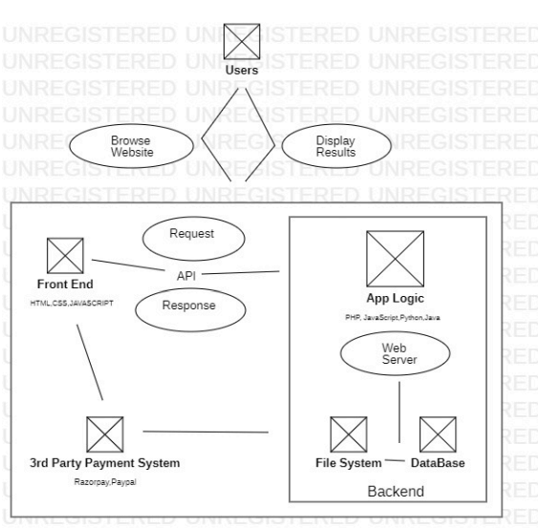
Architecture Diagram
Figure shows the overall application architecture as a whole and is an essential step in the creation of a web application. The user interacting with the website through the two actions of "Browse website" and "Display results" is shown in the diagram below. After receiving user input, the front end of the website makes an API call to the web application's back end in order to display the results. Data is retrieved by the backend application logic from the file system and database and returned in response calls. To manage the payment process, a third-party payment system has been put in place.

Slide 11
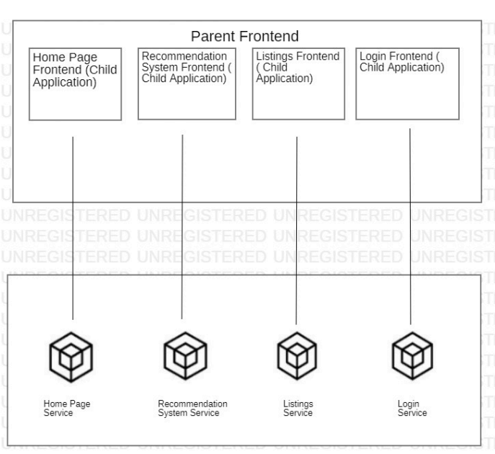
FRONTEND ARCHITECTURE
The frontend architecture of the web application is shown in Figure. The primary components can be separated into four categories: the frontend part for the home page is in charge of the home page display service; the frontend part for the recommendation system is in charge of the recommendation page display service; the frontend part for the listings is in charge of the listings service; and the frontend part for the login is in charge of the login service.

Slide 12
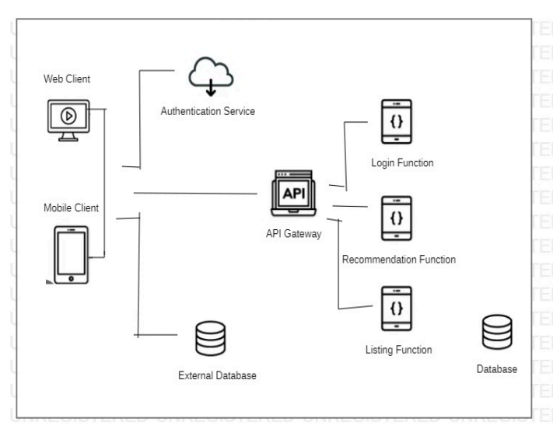
BACKEND ARCHITECTURE
The web application's backend architecture is shown in Figure. The external database that manages login, access, and operations services is linked to the web client and mobile client, as well as the API gateway. The API request activates the Listings, Recommendation, and Login functions, which are linked to an internal database that holds important data.

Slide 13
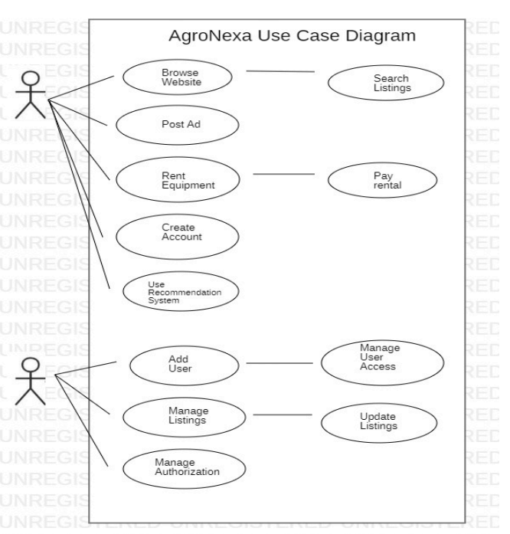
USE CASE DIAGRAM
Figure shows the USER CASE diagram for the specified application. There are two categories of users: "Admin" and "Customer." The customer's use cases include using recommendation systems, renting equipment, paying for rentals, posting ads, searching listings, and browsing websites. Adding new users, controlling user access, managing listings, updating listings, and managing authorization are all included in the admin use cases.

Slide 14
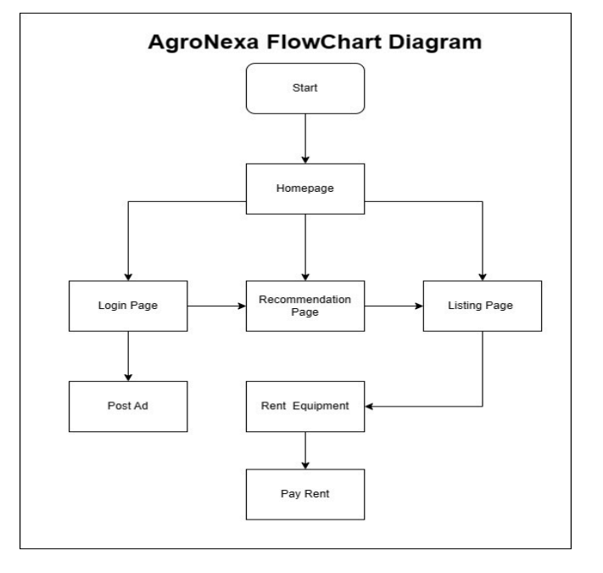
FLOWCHART DIAGRAM
Figure shows the online application's flowchart. The user begins by going to the homepage, from which they can access the listings page, the recommendation page, the login page, or both. The user is redirected from the recommendation page to the listings page, where listings are displayed. He can then click on Rent to be redirected to the equipment rental page, where he can choose his rental options and pay the rental amount. In order to post his own rental listings, he can also access the Post Ad page from the Login page.

Slide 15
Modules Description and Implementation (100%)
Dataset:- About Dataset These days, precision agriculture is popular. It aids farmers in making well-informed decisions regarding farming tactics. I'm going to show you a dataset that will let you create a predictive model that will tell you which crops, given a number of parameters, would be best suited to grow on a specific farm.
Context :-This dataset was build by augmenting datasets of rainfall, climate and fertilizer data available for India. Data fields
N - ratio of Nitrogen content in soil
P - ratio of Phosphorous content in soil
K - ratio of Potassium content in soil
• Temperature - temperature in degree Celsius
• Humidity - relative humidity in % • pH - pH value of the soil • rainfall - rainfall in mm

Slide 16
ALGORITHMS
NAÏVE BAYES
The Naive Bayes algorithm is a machine learning technique used for classification tasks. It's based on Bayes' theorem, which calculates the probability of an event given prior knowledge of conditions related to that event. Naive Bayes simplifies this by assuming that features are independent, even if they may not be in reality. Despite this simplification, it often performs remarkably well in text classification, spam filtering, and sentiment analysis. Naive Bayes is computationally efficient, requires relatively small amounts of data for training, and can provide quick predictions, making it a popular choice for a wide range of applications in natural language processing and machine learning.
SVM
Support Vector Machine (SVM) is a powerful machine learning algorithm used for classification and regression tasks. It works by finding the optimal hyperplane that best separates data points into different classes. SVM aims to maximize the margin, which is the distance between the hyperplane and the nearest data points of each class. This approach not only results in accurate classification but also offers robustness to outliers. SVM can handle both linear and non-linear data by using various kernel functions. It's widely used in image recognition, text classification, and bioinformatics, among other fields, due to its ability to handle complex data and provide high accuracy.
K-NEAREST NEIGHBOR
K-Nearest Neighbors (KNN) is a machine learning algorithm used for classification and regression tasks. It operates on the principle of similarity, where an object is classified based on the majority class of its K nearest neighbors in the feature space. KNN is a non-parametric, instance-based learning method, meaning it doesn't make underlying assumptions about the data distribution. It's versatile and can handle both classification and regression problems. However, its performance may be sensitive to the choice of K and the distance metric. KNN is simple to understand and implement, making it a popular choice for various applications in pattern recognition and recommendation systems.

Slide 17
RANDOM FOREST Random Forest is a versatile machine learning ensemble method used for classification and regression tasks. It constructs multiple decision trees during training and combines their outputs to make predictions. Each tree is trained on a random subset of the data and features, which helps reduce overfitting and increases accuracy. Random Forest is robust, handles high dimensional data, and provides feature importance rankings. It's widely used for tasks such as image classification, anomaly detection, and recommendation systems. Its ability to handle complex data and maintain predictive accuracy makes it a popular choice in many applications, including data science and predictive modeling. ADABOOST AdaBoost, short for Adaptive Boosting, is a popular ensemble machine learning algorithm. It works by combining the outputs of multiple weak learners, typically decision trees, to create a strong classifier. AdaBoost assigns different weights to data points and focuses on the samples that are misclassified in each iteration, allowing it to give more attention to challenging examples. The final prediction is a weighted sum of the individual learners' outputs. AdaBoost is particularly effective in improving classification accuracy and is used in face detection, text classification, and other applications. Its adaptability and the ability to boost the performance of weak models make it valuable in machine learning.

Slide 18
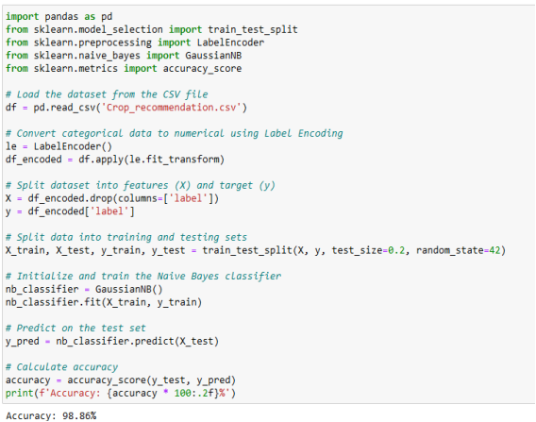
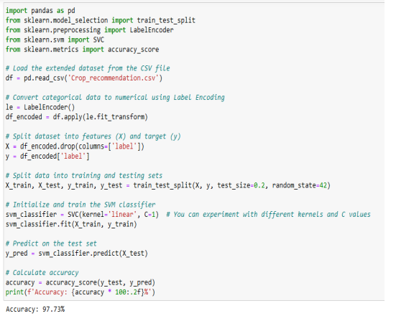
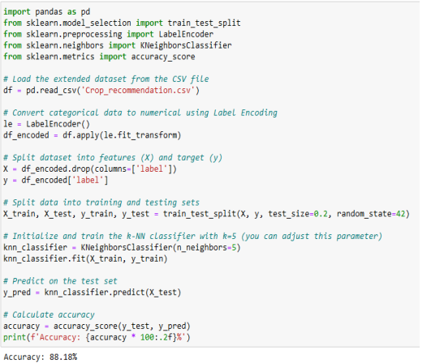
Algorithm implementation
Naïve Bayes
SVM
K-NEAREST NEIGHBOR

Slide 19
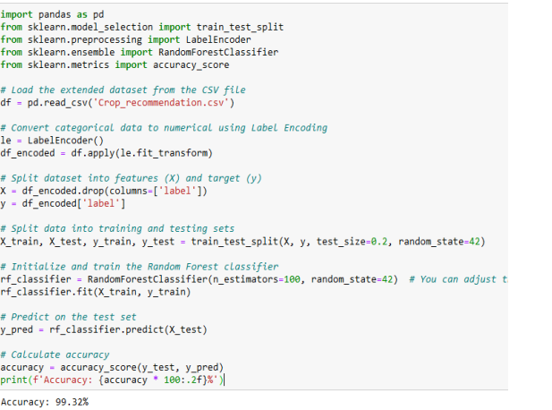
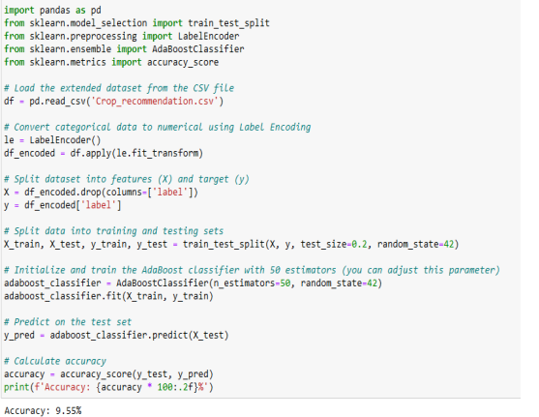
RANDOM FOREST
ADABOOST

Slide 20
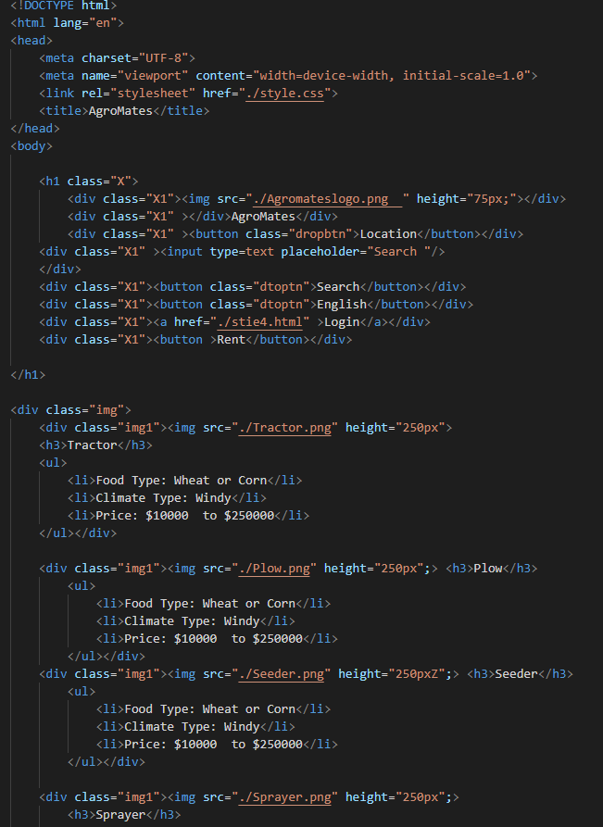
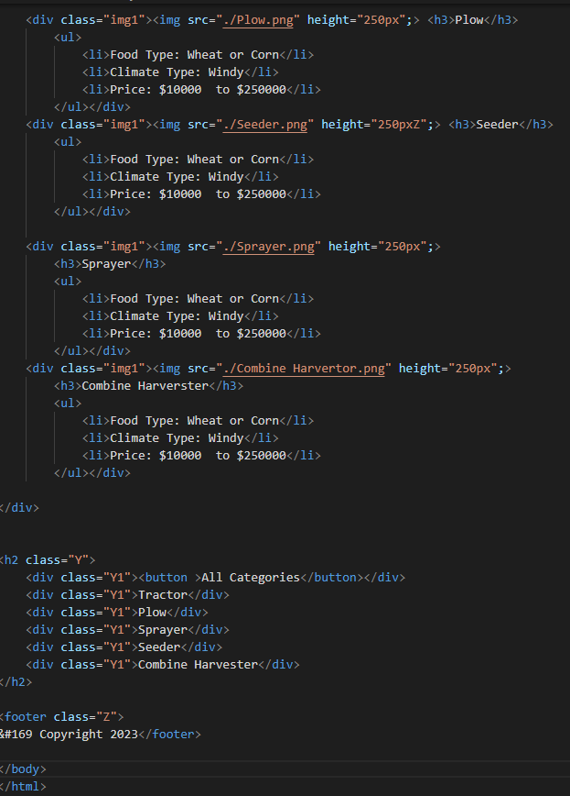
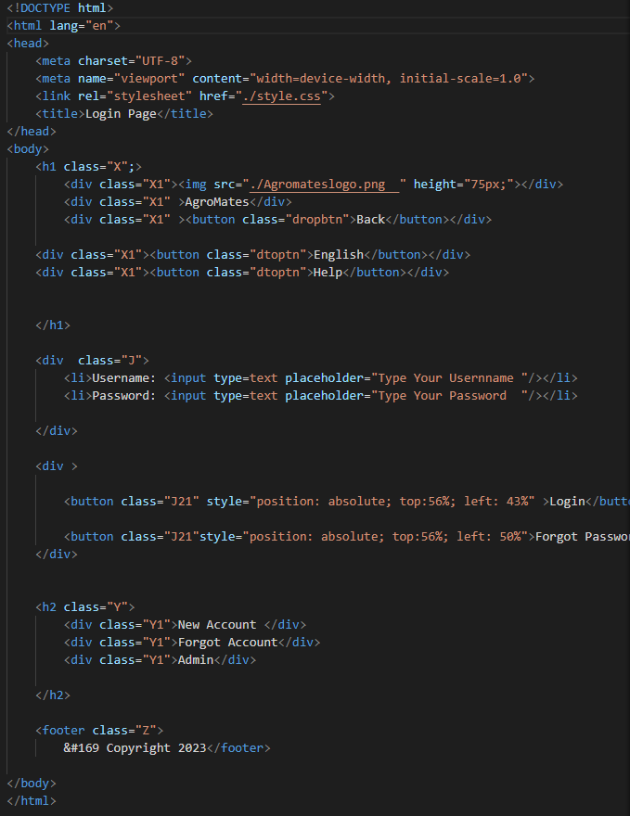
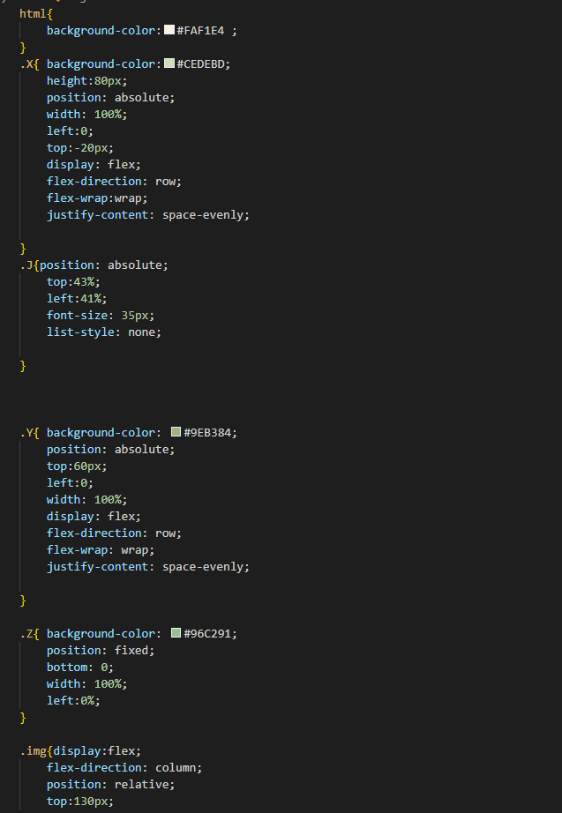
Portal Code: 100% implementation:

Slide 21
Results and Discussion

Slide 22
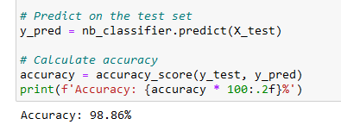
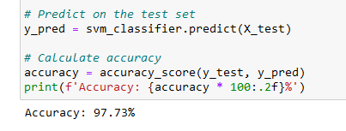
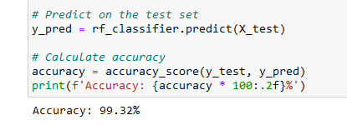
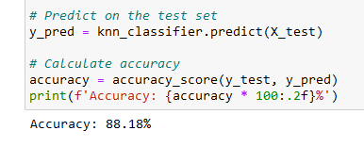
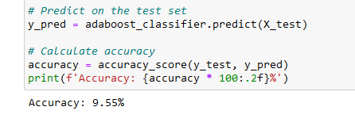
Accuracy Measures:-
NAÏVE BAYES Accuracy : 98.86%
SVM Accuracy : 97.73%
K-NEAREST NEIGHBOUR Accuracy : 88.18%
RANDOM FOREST Accuracy : 99.32%
AdaBoost Accuracy : 9.55%

Slide 23
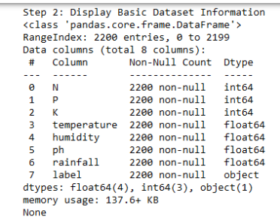
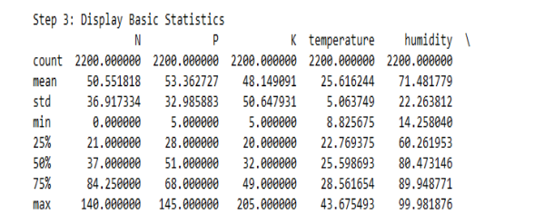
DATASET ANALYSIS USING VARIOUS METRICS

Slide 24
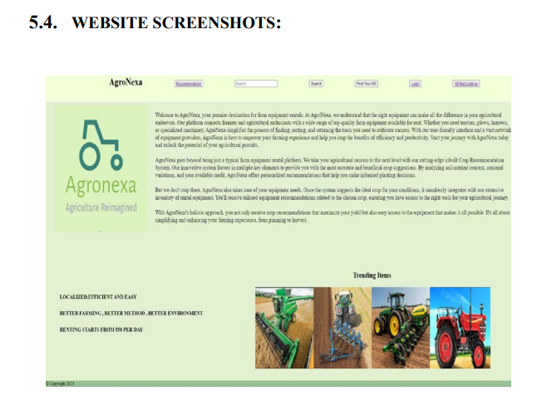
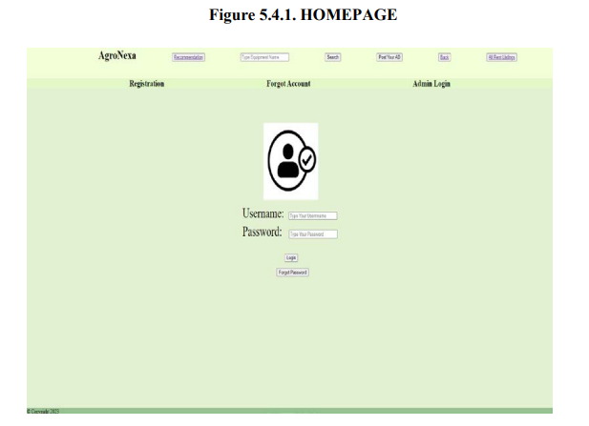
Output and Screenshots

Slide 25
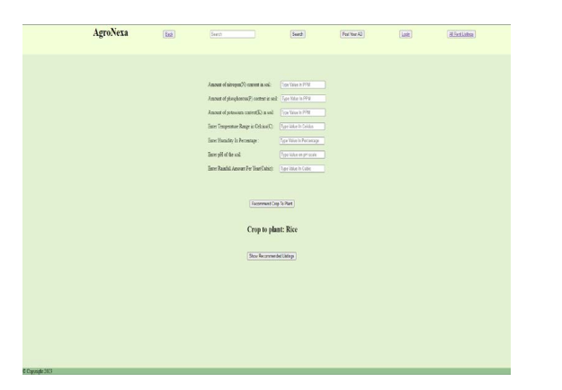
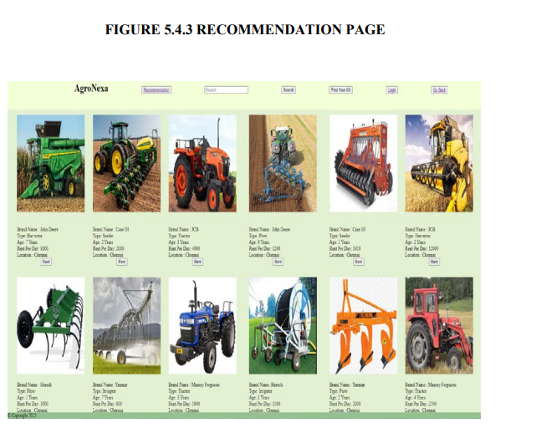

Slide 26
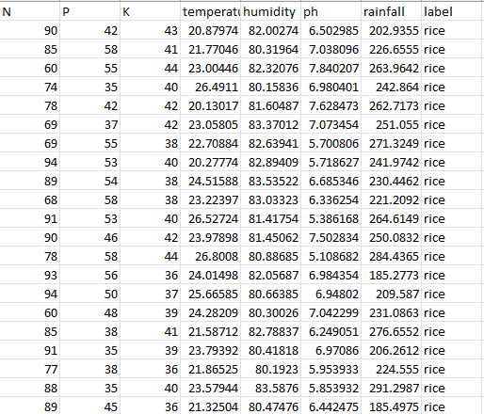

Slide 27

References
[1] R. Sneha Iyer, R. Shruthi, K. Shruthhi and R. Madhumathi, "Spry Farm: A Portal for Connecting Farmers and End Users," 2021 7th International Conference on Advanced Computing and Communication Systems (ICACCS), Coimbatore, India, 2021, pp. 429-433, doi: 10.1109/ICACCS51430.2021.9441815..URL: https://ieeexplore.ieee.org/stamp/stamp.jsp?tp=&arnumber=9441815&isnumber=9441544
[2] Md Iqbal, Vimal Kumar and Vijay Kumar Sharma, “Krishi Portal: Web Based Farmer Help Assistance”, International Journal o f Advanced Science and Technology, vol. 29, pp. 4783-4786, 2007.
[3] Sheetal Bhagwat et al, “Survey Paper on E-Mandi A Market Exchanging Between Farmers and End-user”, International Research Journal o f Engineering and Technology, vol. 6, 2019.

Slide 28
thank you
Ayush Srivastava (RA201100301759) and Hansa Verma (RA2011003010799)

